Slide 1
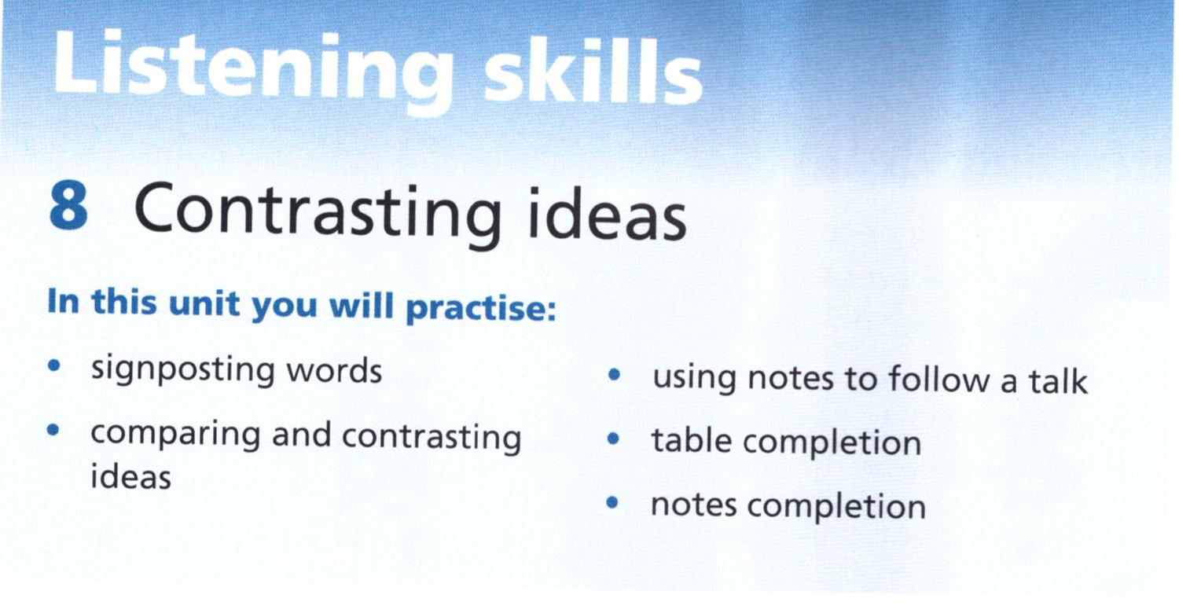

Slide 2
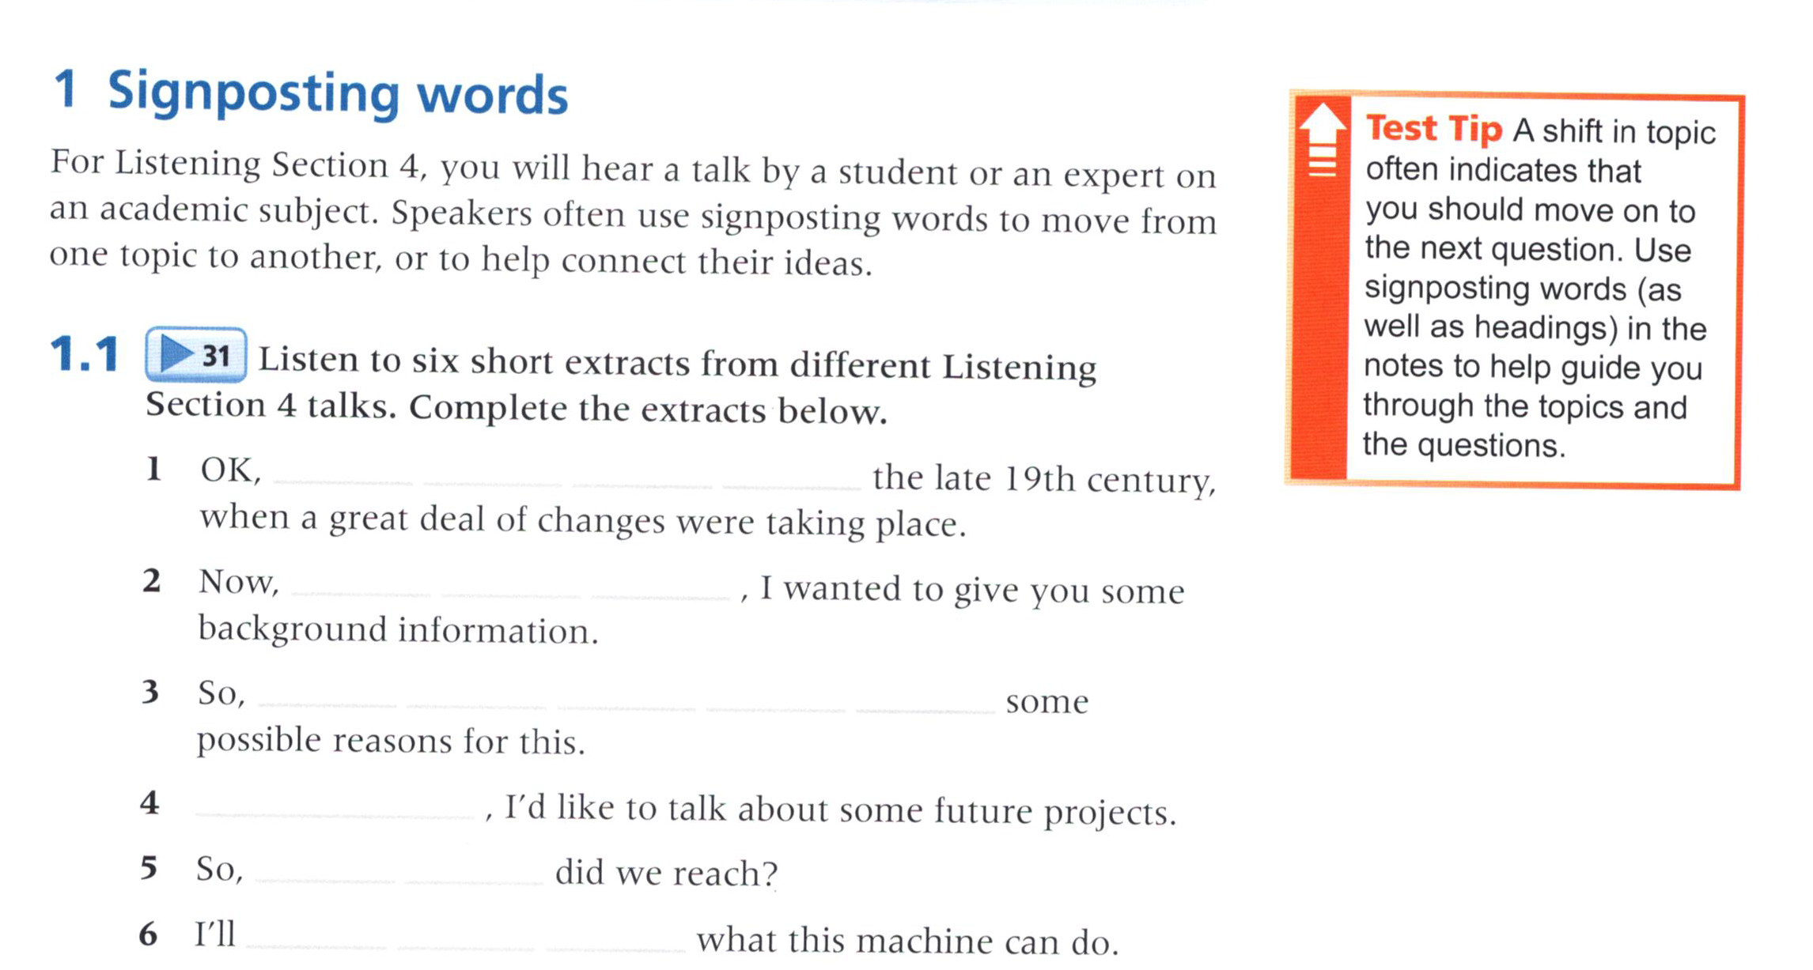
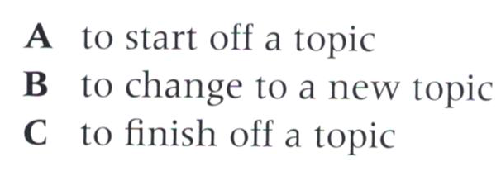
31
Let’s move on to
first of all
Function of signposting words
let’s have a look at
And finally
what conclusions
begin by explaining

Slide 3
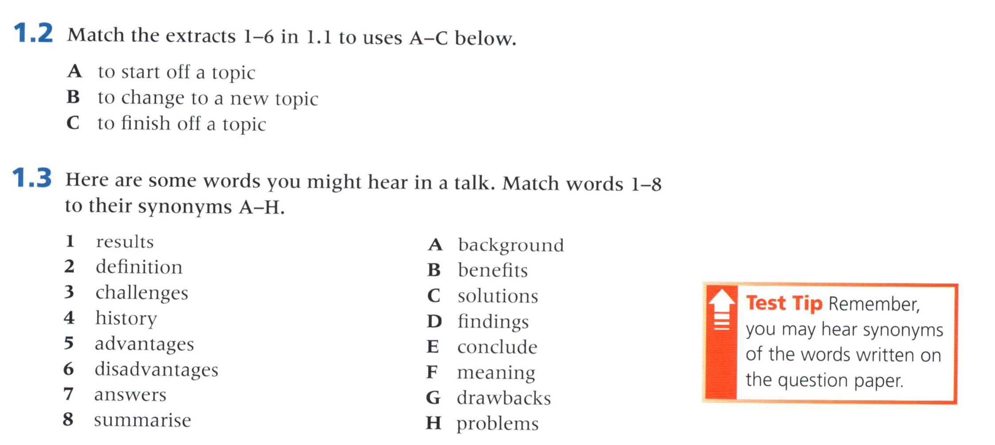
2
6
1
3
4
5

Slide 4
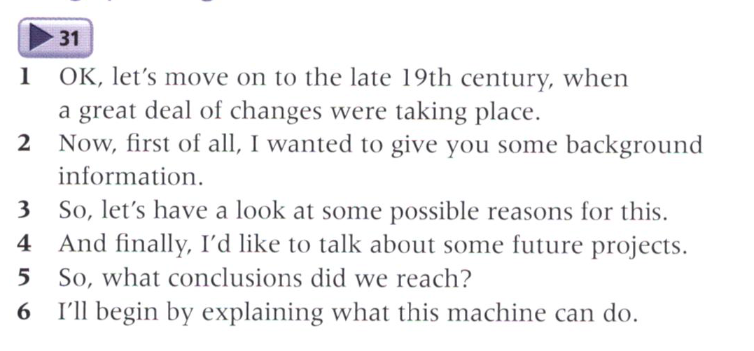
31

Slide 5
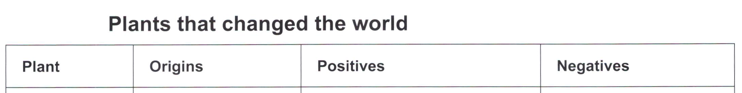
Take notes by following the clues given.
32
Make predictions
Compare your notes with the notes on P 40.
staple 主食
white Mulberry桑树
cash crop 经济作物

Slide 6
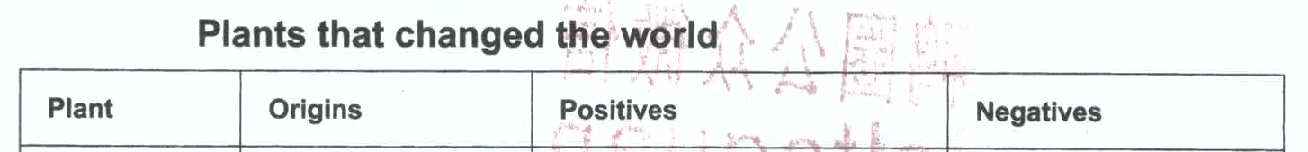
potato | Central&south US 16th century | Alter diet New trend, change lives | Crop disease Failure Starvation
tobacco | Americas | Influence way of development Cash crop--fund development | Demand for slave War between N &S
tea | China | Independence from UK | Tax– US revolution
White Mulberry | China | Influence development Esp. establish trade between E&W | Spread of disease and weapon s

Slide 7
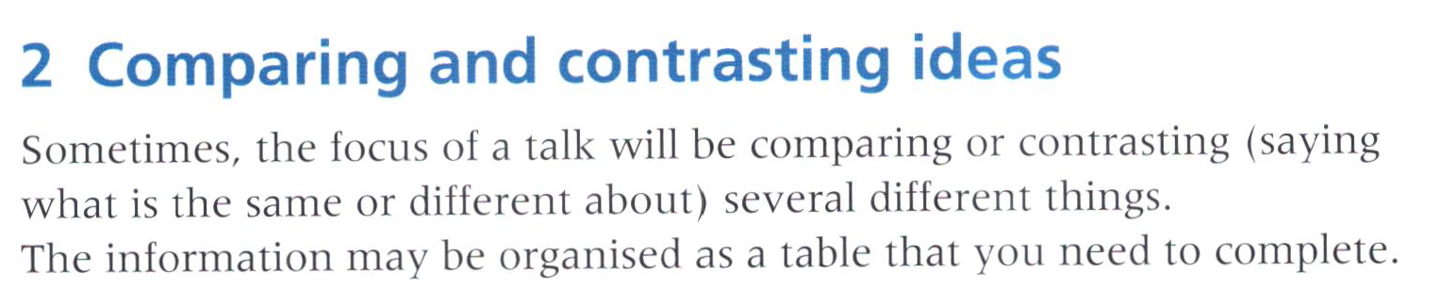
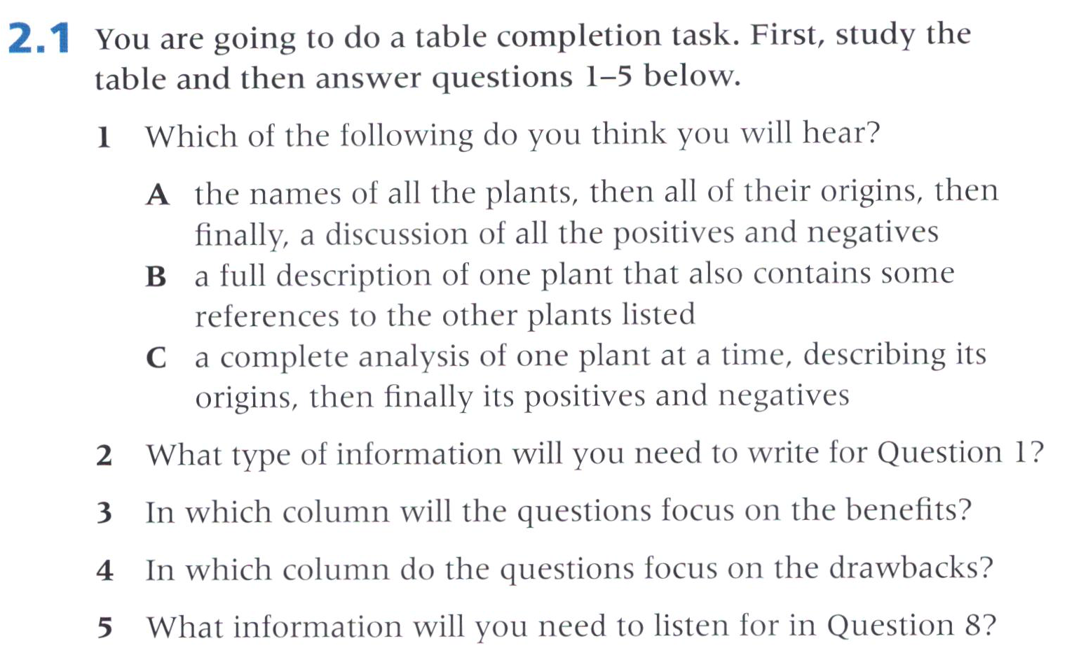
Make predictions
a place
the third column
the last column
the name of a plant

Slide 8
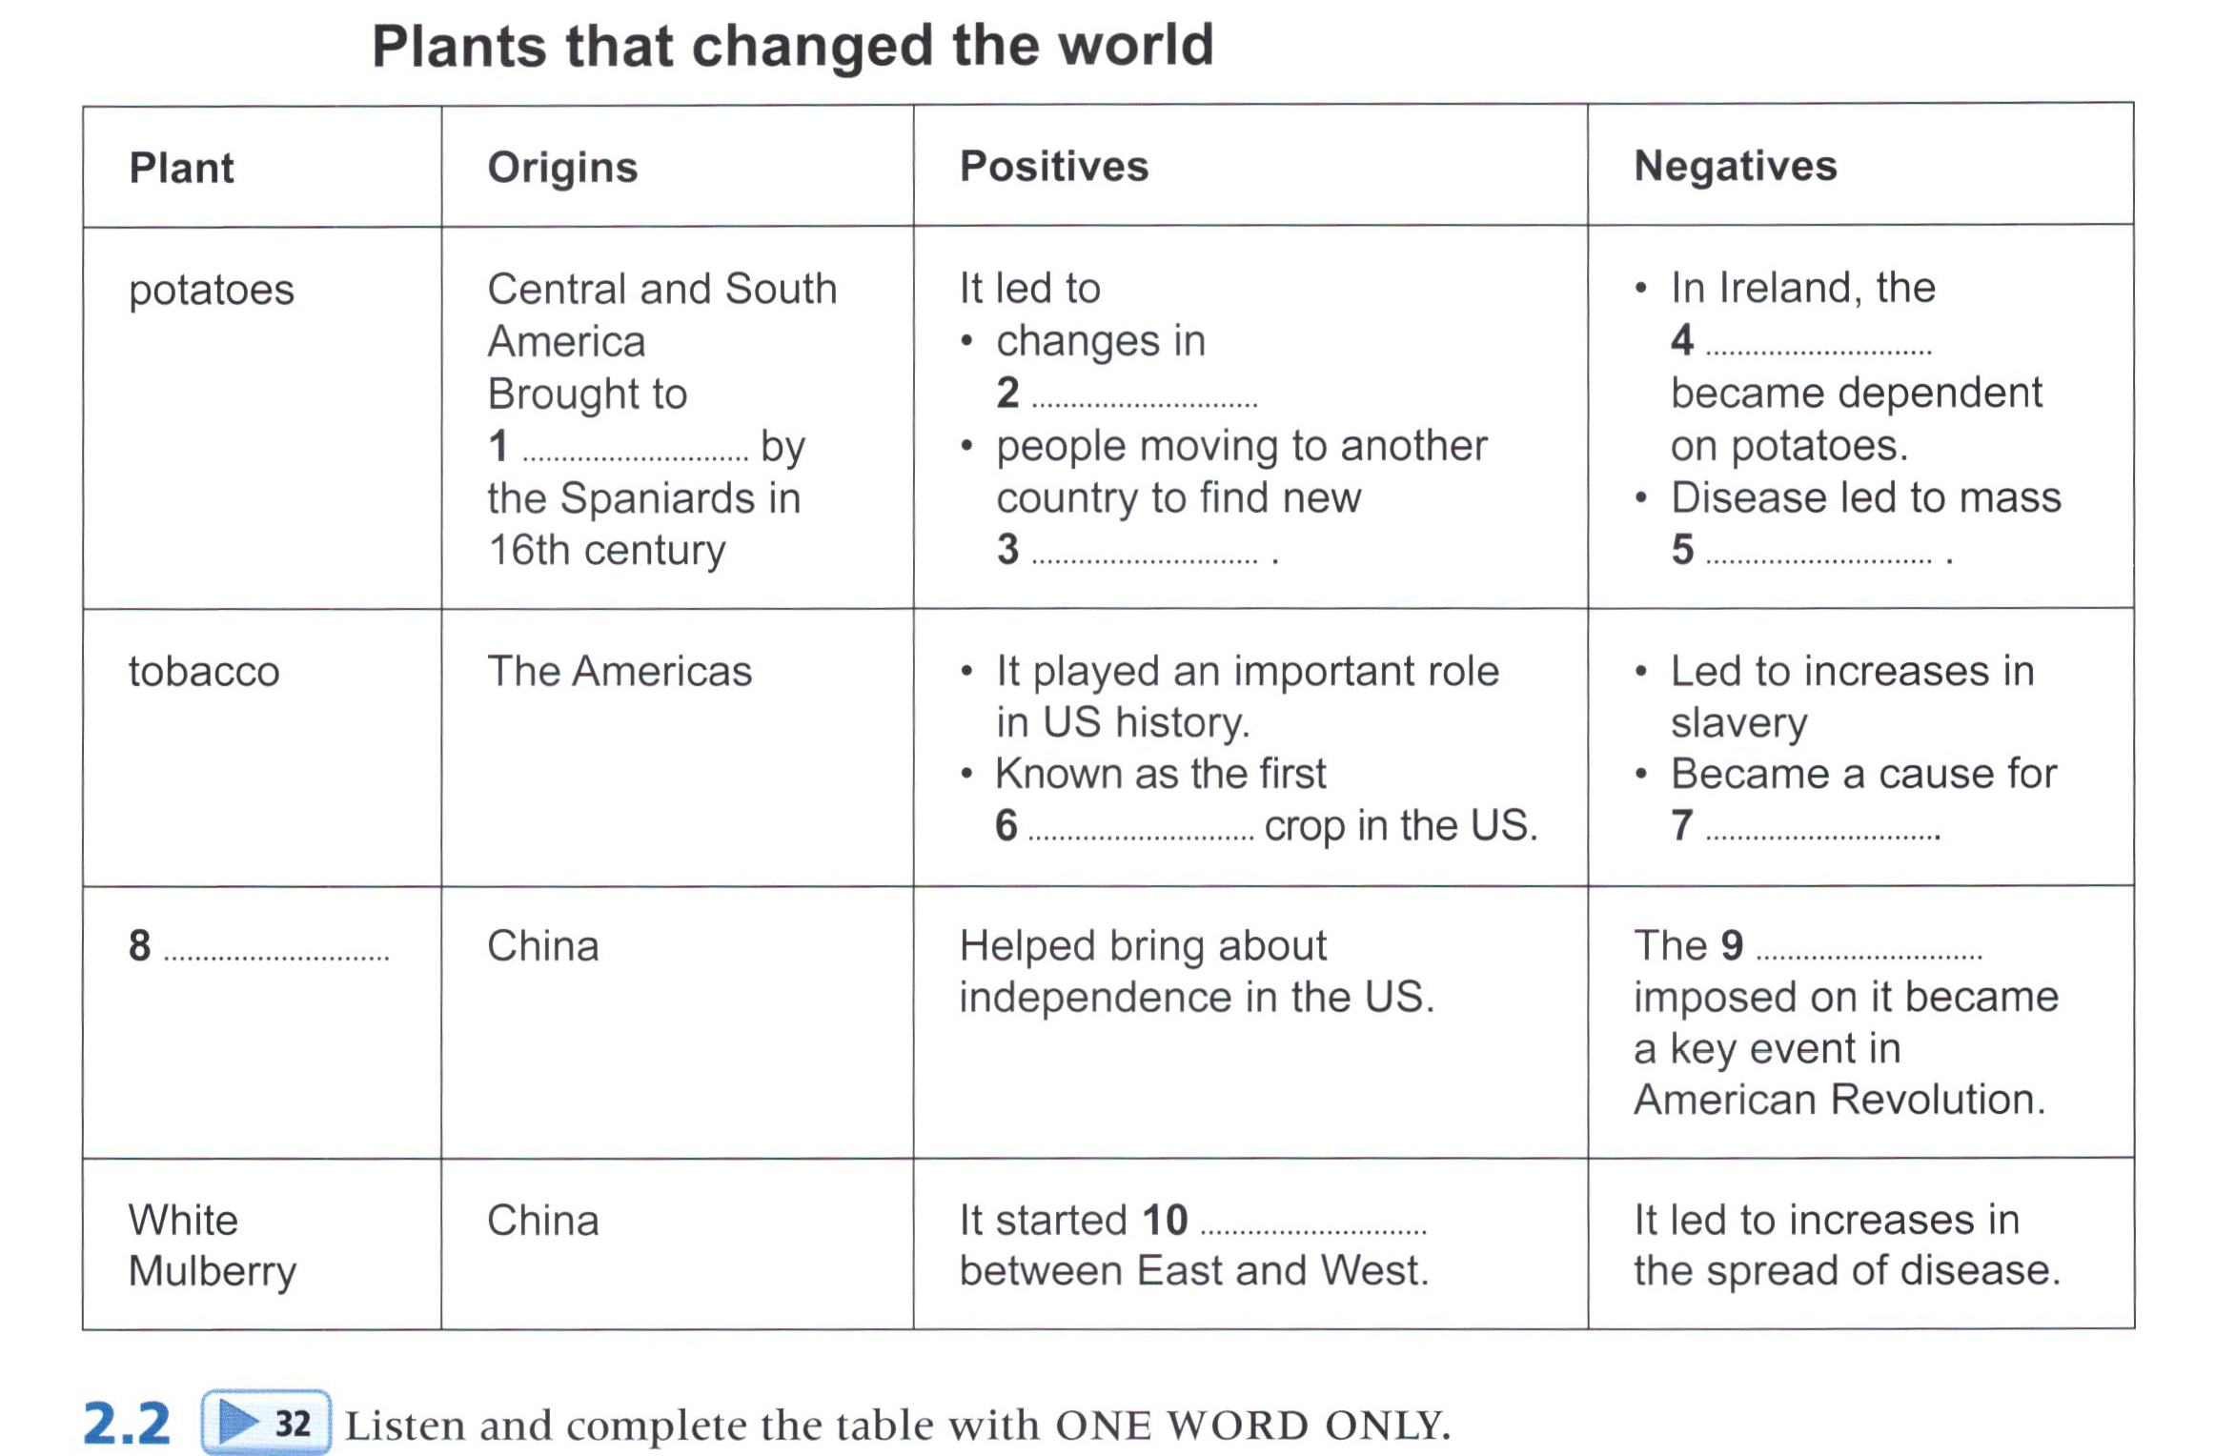
32
poor
diet(s)
Europe
lives
starvation
cash
war
tea
tax(es)
trade

Slide 9
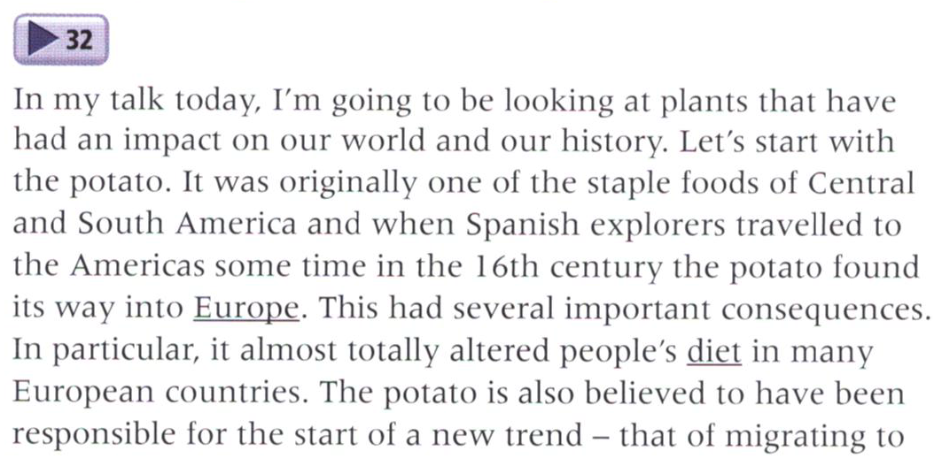
32

Slide 10
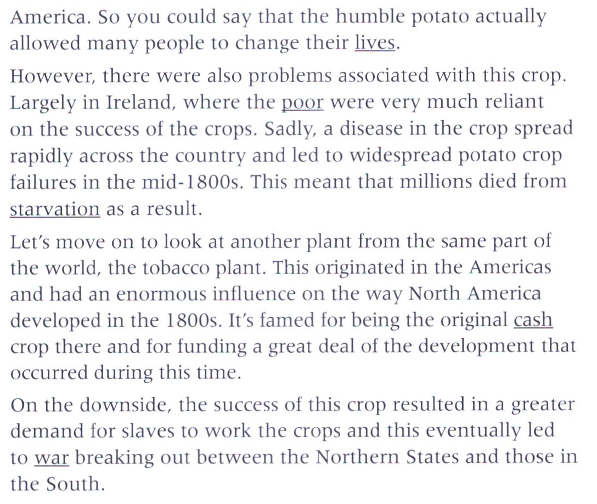

Slide 11
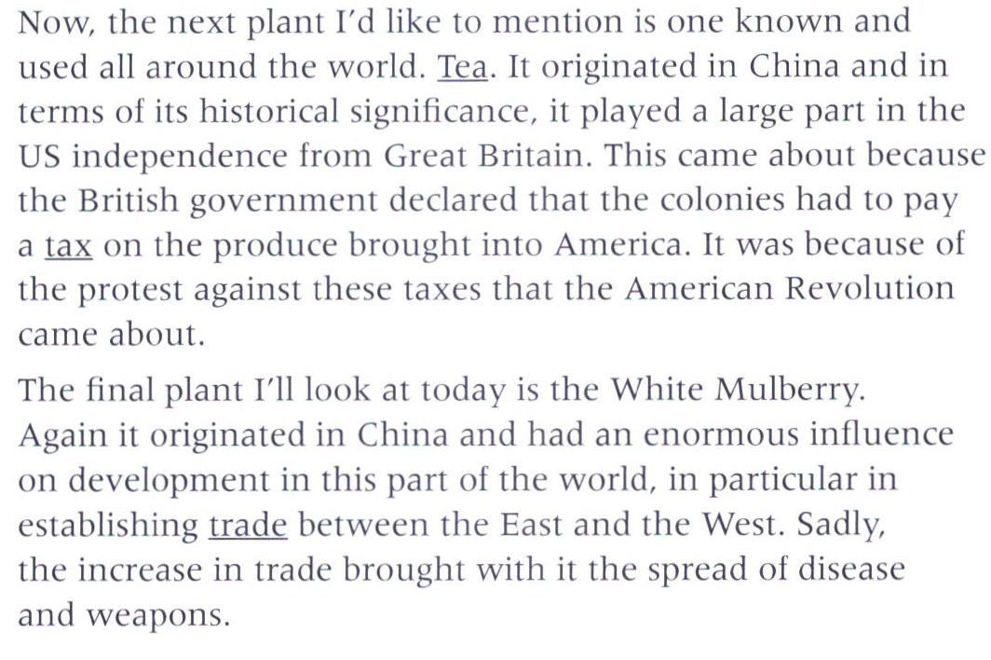

Slide 12
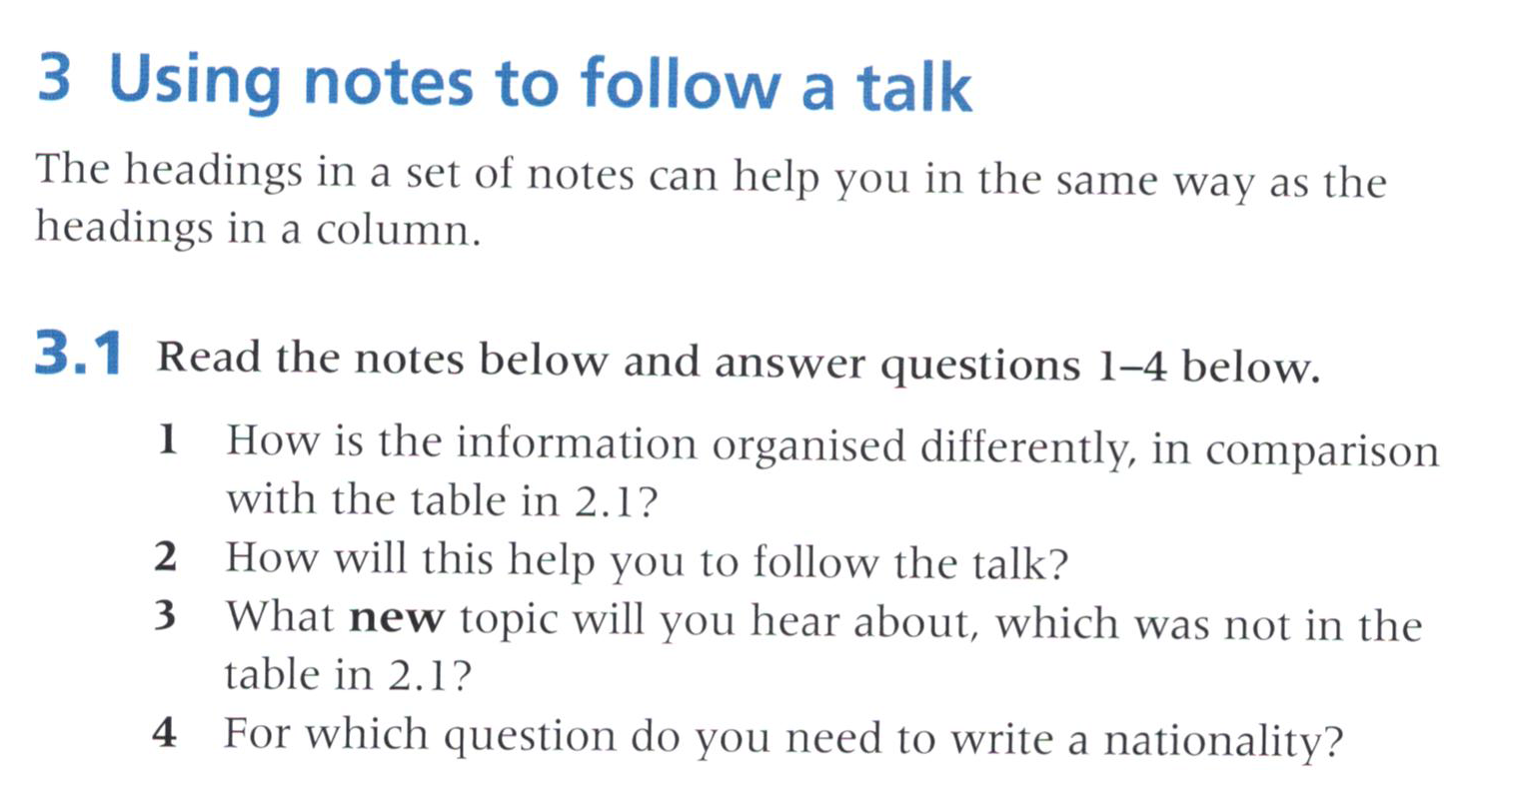
1. It’s organised chronologically (by year) and it takes a historical view
2. You can listen for the dates to help you follow the talk.
3. prehistory
4. Question 6

Slide 13
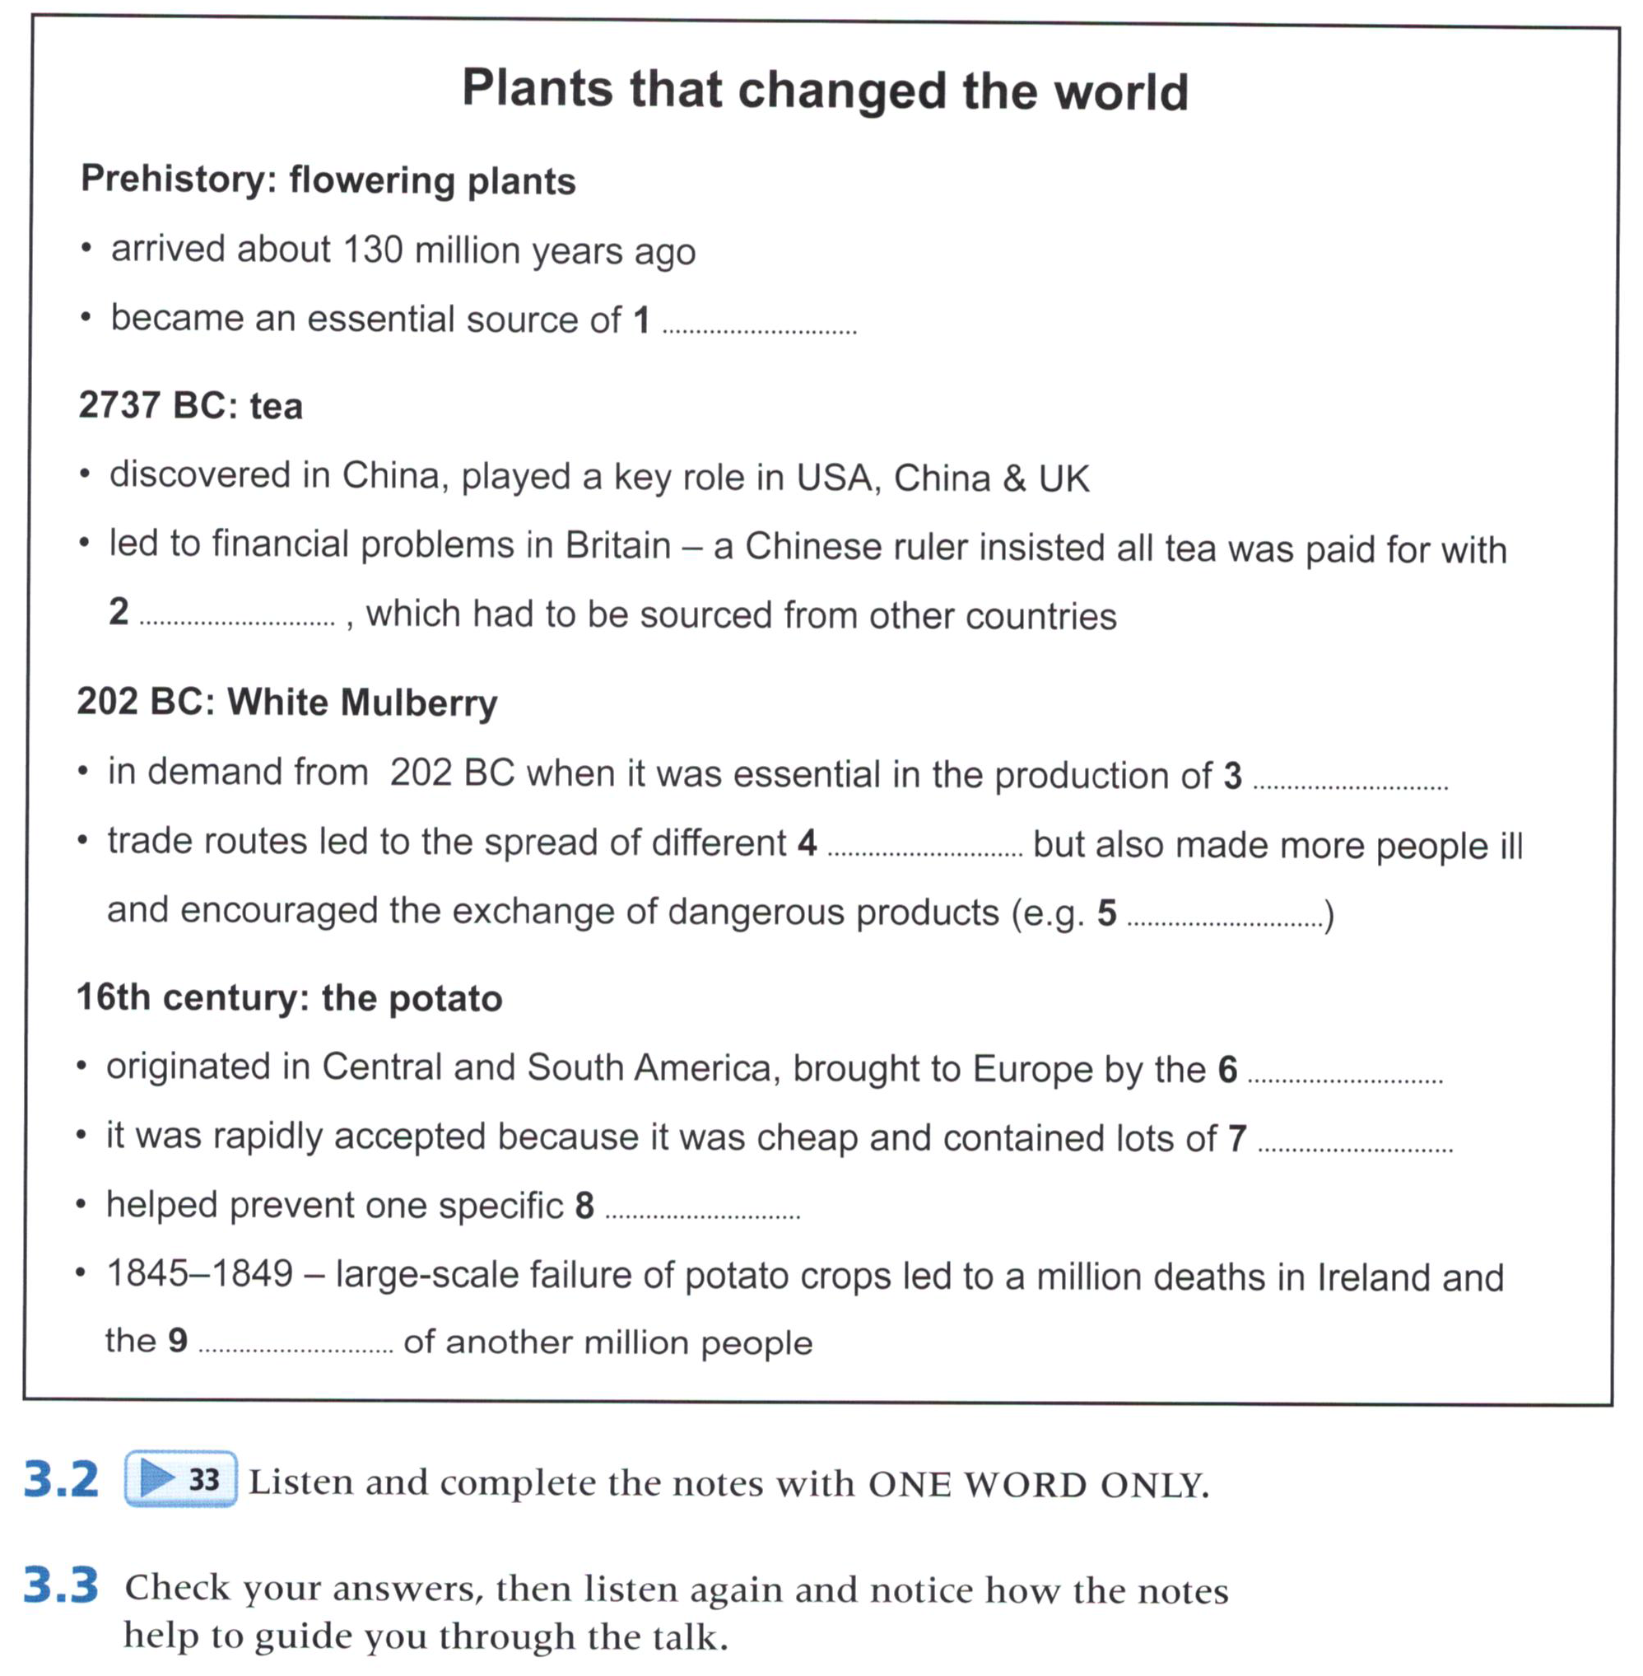
33
food
silver
silk
religions
gunpowder
Spanish
vitamins
disease
emigration

Slide 14
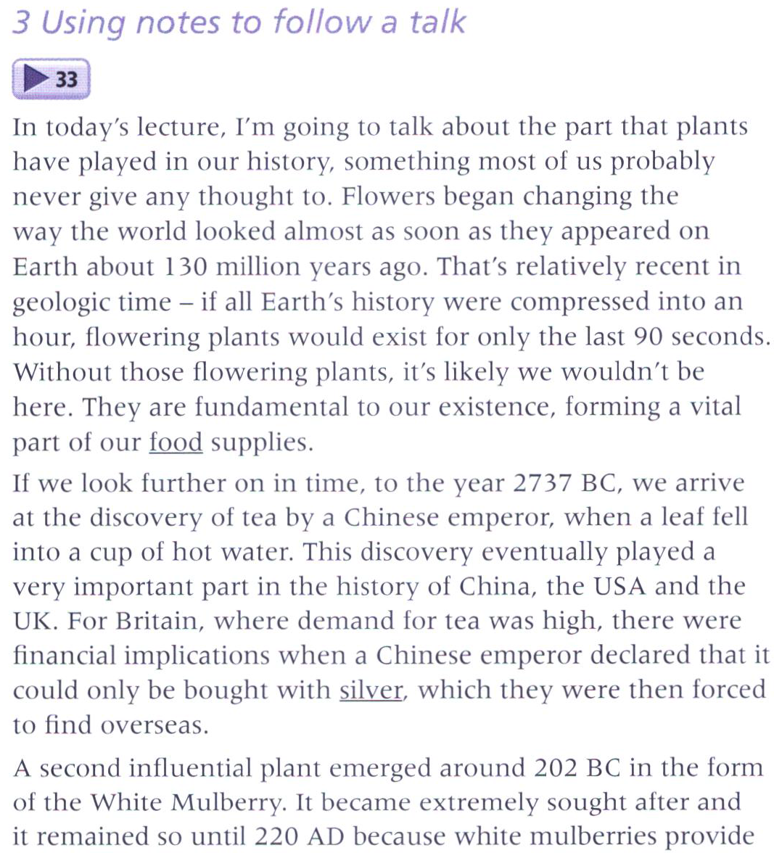
33

Slide 15
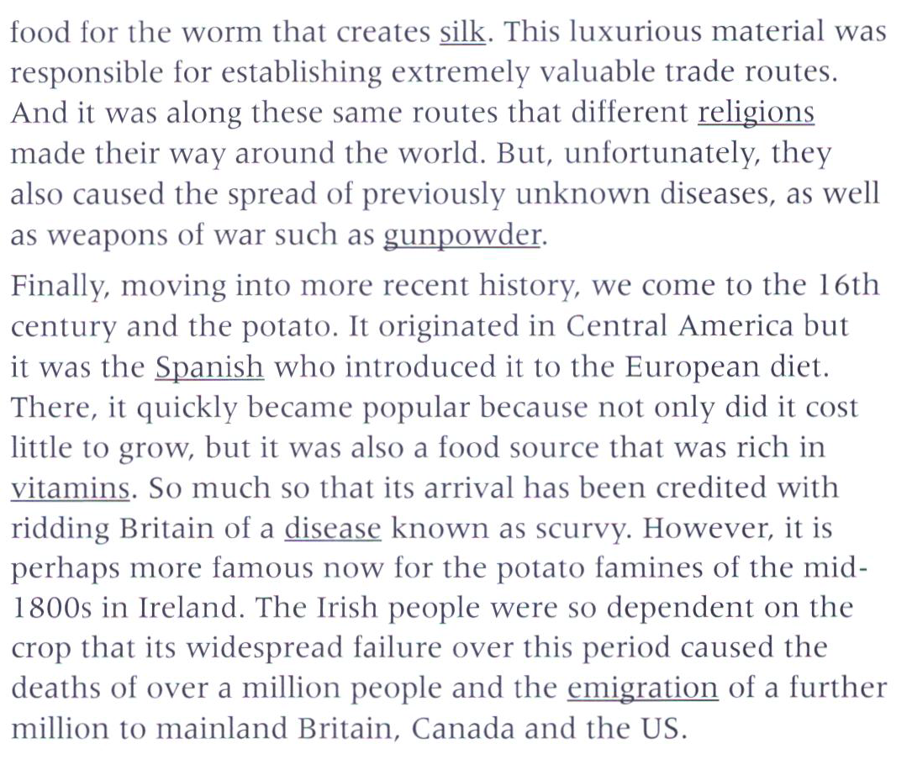

Slide 16
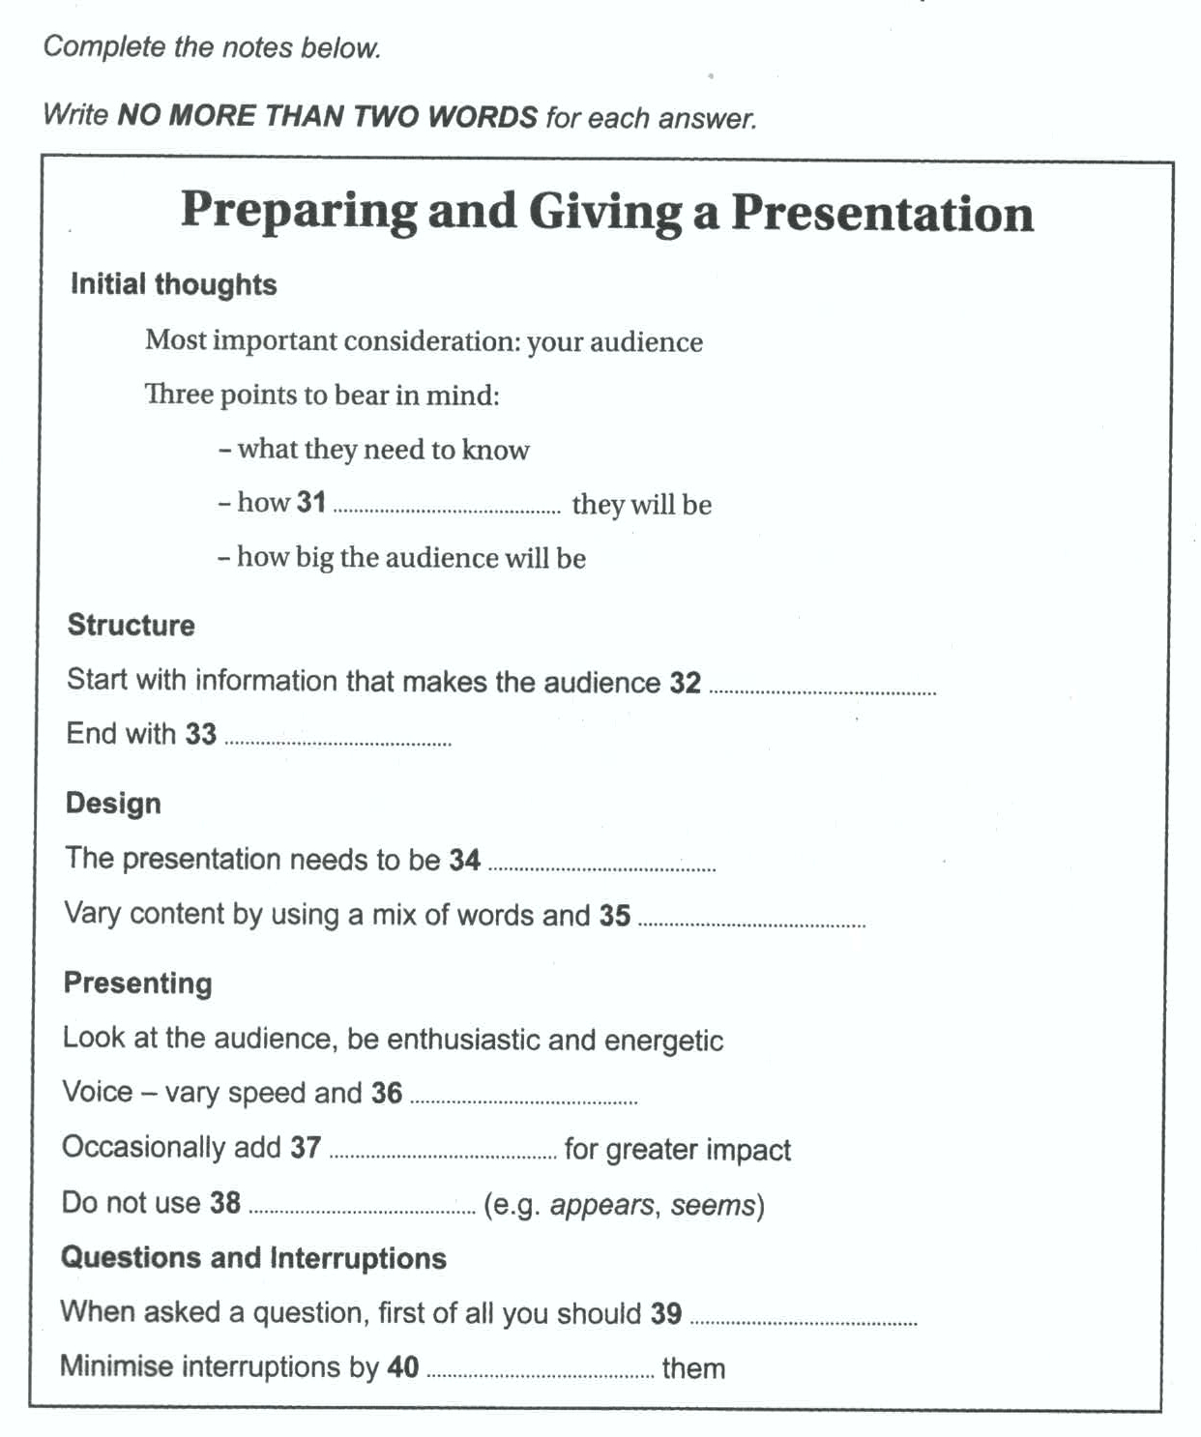
46
supportive
pay attention
next steps
consistent
graphics
tone
(a) silence/silences
weak verbs
repeat it
predicting

Slide 17
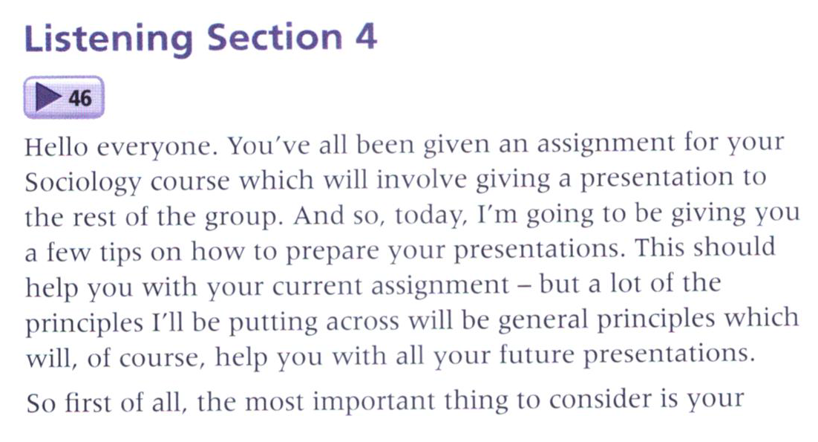
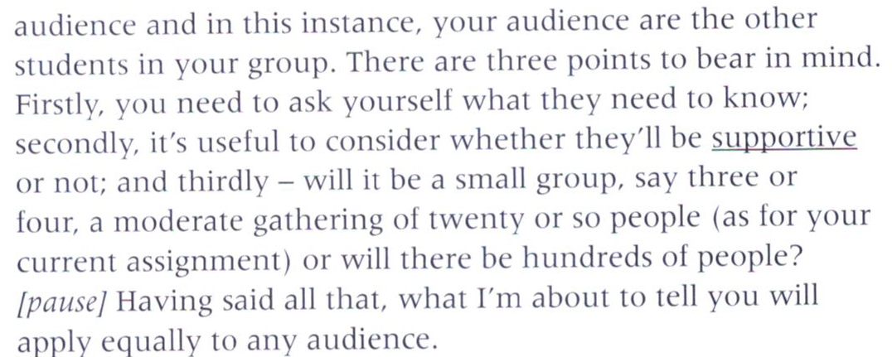
46

Slide 18
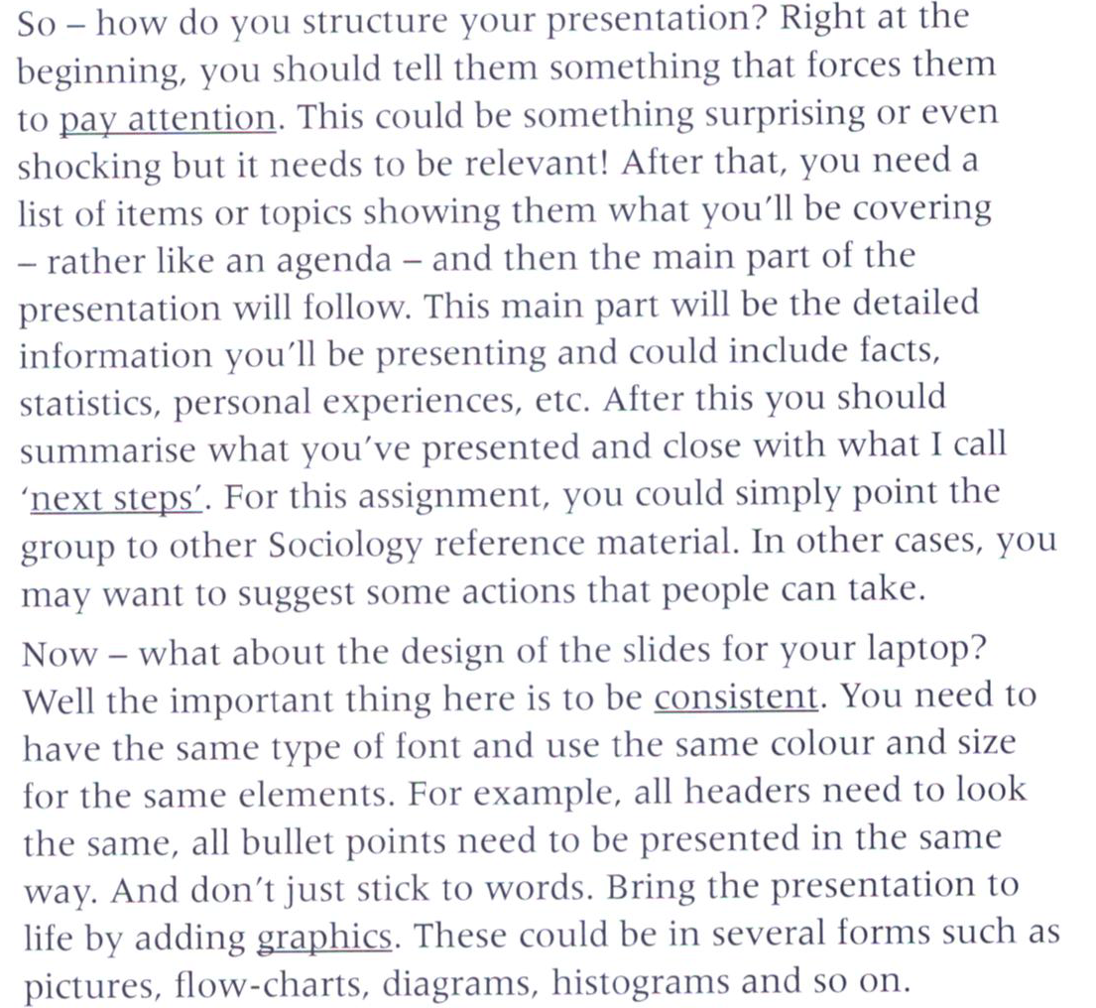

Slide 19


Slide 20
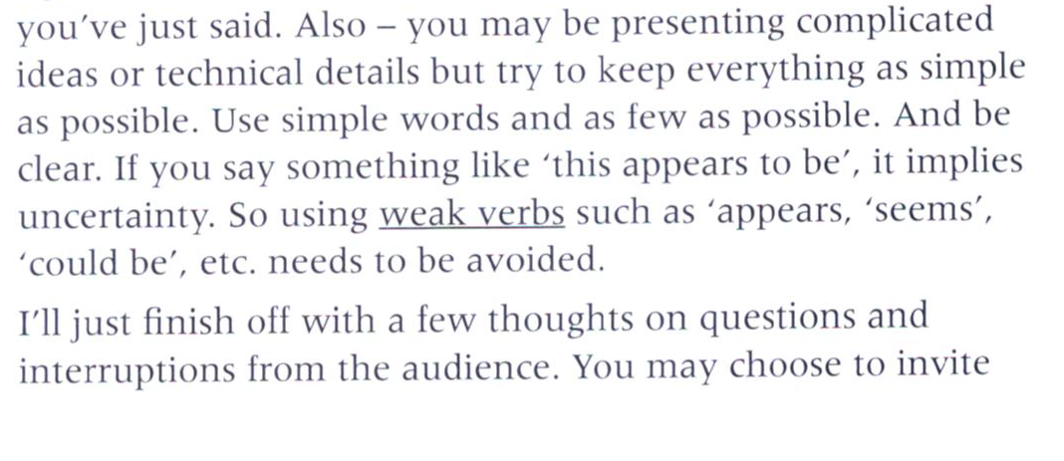

Slide 21
